Slide 1
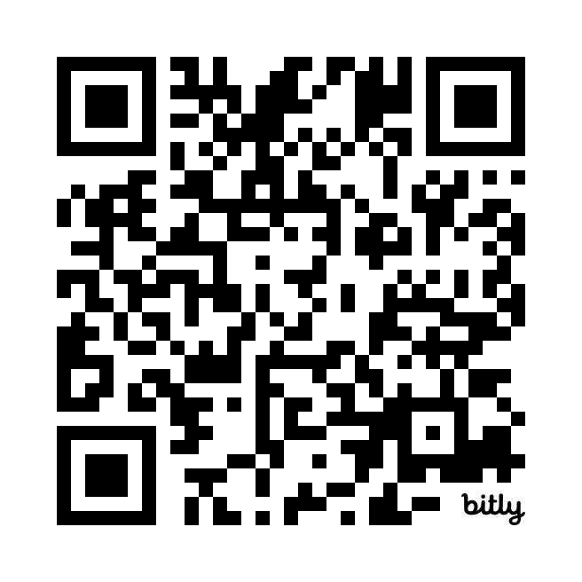
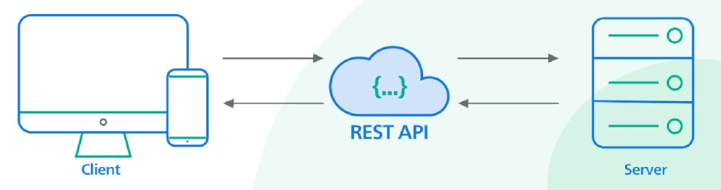
RESTful APIs Quiz
https://bit.ly/3xhxPpx

